Slide 1
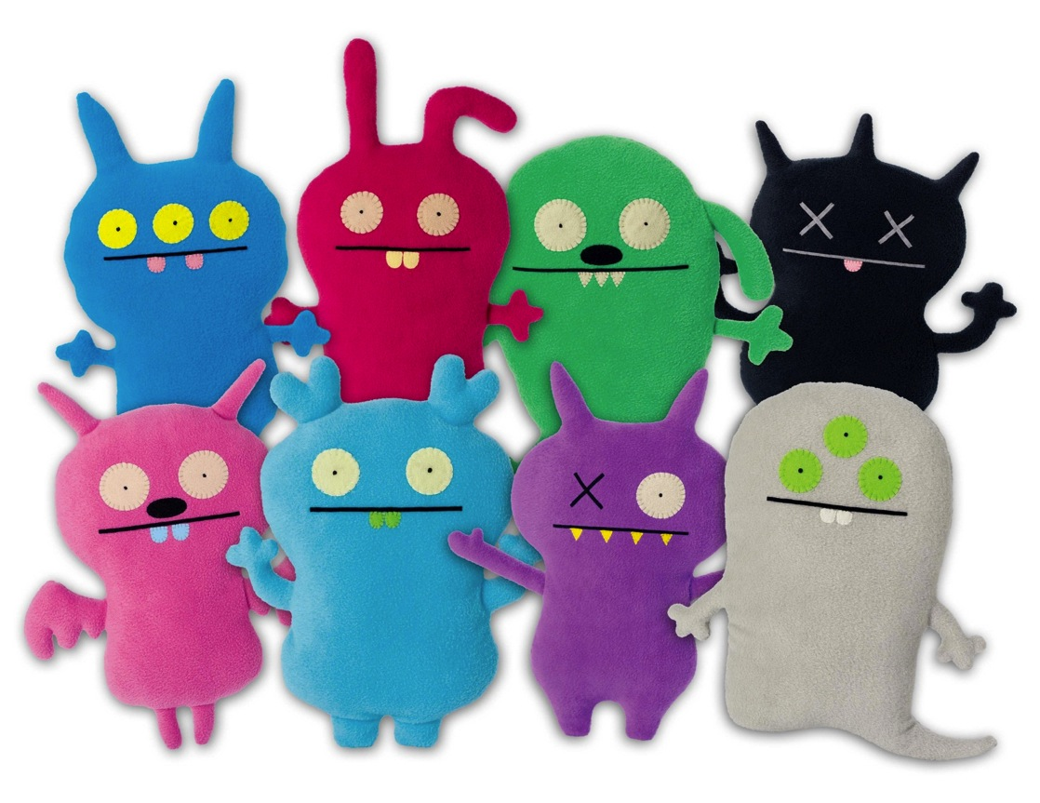
3D Art 7/8 Ms. Shepherd
Ugly Doll Project

Slide 2
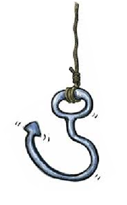
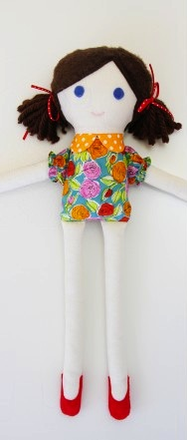
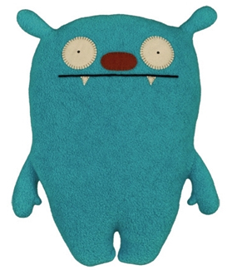
Hook
Which doll do you prefer?
Give a reason and come up
and ‘post-it’ on the board
challenge⁺
Why has its material been chosen?
Is it suitable for a child?
How do you know?
I like this one because it’s color is calming
3 min

Slide 3
Learning Objective By the end of the lesson, you will understand… | Learning Outcomes By the end of the lesson, you will be able to…
I can analyse a product in detail, then redesign it according to a client’s needs. | Level 3 I can describe ways in which a product can be suited to a customer.
 | Level 3 I can explain why analysing a product is important in the design process
 | Level 4 I can use my analysis to inform my creative decisions. I use my design thinking to create inventive proposals.
Key Words: Analyse, Inform, Describe, Propose

Slide 4
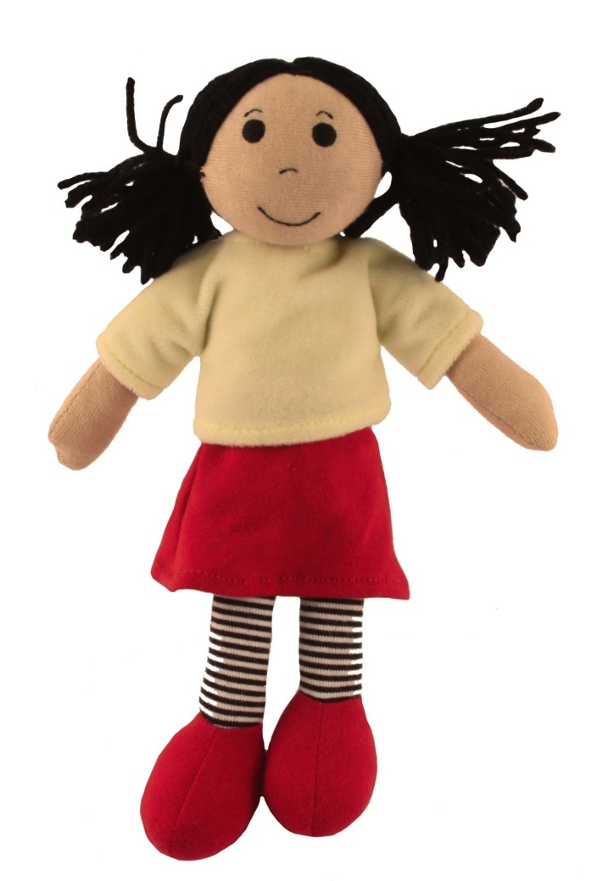
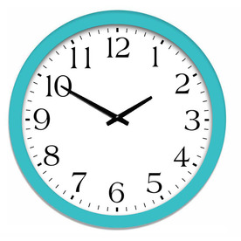
First, we are going to analyse this doll.
You have two minutes to very quickly sketch this doll in the box on your page.

Slide 5
15 Minutes
When we are analysing and evaluating we use ACCESS FM acronym.
Aesthetics (What it looks like)
Customer (Who will buy it?) Cost (How much to manufacture, how much to sell?) Environment Size (in cm) Safety Function Materials
Aesthetics
This product looks fun, it looks like it has been made from soft materials such as fleece and it’s colours are bright and engaging. The seams of the fabric have been neatly sewn.
challenge⁺
Your customer is now a one year old. How would you change it so that it is safe? Adapt and label your sketch

Slide 6
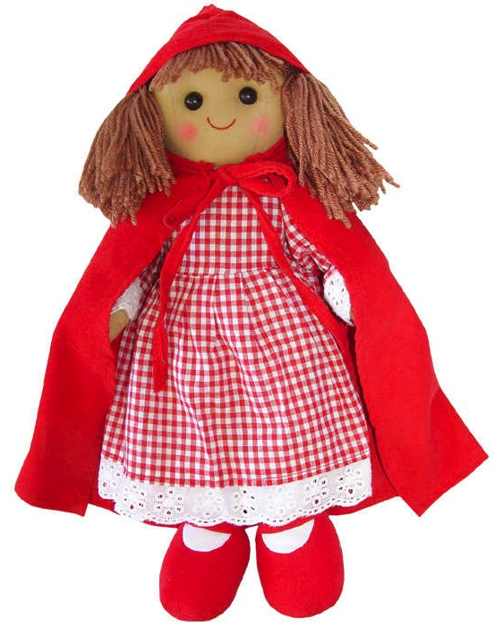
Analysing products in design is important because it lets us understand lots of things about that product and who it is aimed at.
One way of showing that you understand how to analyse a product properly is by changing one of its factors.
Discuss in Pairs
At what age is this doll suitable for use?
How may we change it so that it is suitable from birth?
3 mins

Slide 7
Choose one of the dolls from your packet.
Choose one customer from the list below and create a mind map for their ‘needs’. You must then re-design the chosen doll for that customer.
Baby Girl
Boy Aged 4
Blind Girl
35 mins
challenge⁺
Design a doll that would be suitable for a seven year old girl and will help teach her how to tell the time. Render and annotate.
Notes:
Peer Assessment after fifteen minutes

Slide 8
Peer Assessment
Using the criteria given, you must level your partners work.
Give two strengths to their work and two areas for improvement.
Did their new design outcome have details and color?
Did they include notes about how to manufacture the doll, what materials to use, etc?
Is their design accurate to their child’s age group or needs?

Slide 9
Learning Objective By the end of the lesson, you will understand… | Learning Outcomes By the end of the lesson, you will be able to…
How to analyse a product in detail, then redesign it according to a changing factor. | Level 3 I can describe ways in which a product can be suited to a customer.
 | Level 3 I can explain why analysing a product is important in the design process
 | Level 4 I can use my analysis to inform my creative decisions. I use my design thinking to create inventive proposals.
Key Words: Specification, Customer, Analysis, Context
SMSC: Work well with others, empathise with different types of people

Slide 10
One question about the project
Two things you found difficult
Three things you have learnt

Slide 11
Specification
Next lesson we will be talking about specifications.
Refresh: What is a specification?
A design specification provides explicit information about the requirements for a product and how the product is to be put together (manufactured).
challenge⁺
What would happen if we didn’t create specifications when designing products/garments?

Slide 13
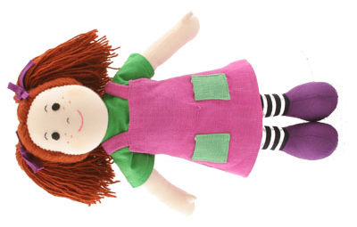

Slide 14
